Slide 1
Expectation Maximization Algorithm
Hoachen Sun, Jun Feng, Andrew Tran, Zhao Wang

Slide 2
Presentation Outline
Maximum Likelihood Estimation
EM Algorithm concept
Akaike Information Criterion
Shiny Demonstration
Notes:
We want to briefly go over the concept of the maximum likelihood estimation so that we can address the EM algorithm more precisely. The idea is that the maximum likelihood of some parameter, like the mean, can estimated/found based on the sample of data. This example works great when the data comes from a single distribution.
If we are looking at a set of data that has several distributions or mixture distributions, we can compute a set of joint likelihood functions to find the set of parameters from each data point. The EM algorithm is an iterative process used to approximate the maximum likelihood function for the mix of distributions in a single set of data.
The number of distributions or modes in a mixture may not be known. The Akaike Information Criterion provides an estimate about the number of modes in the dataset.
Lastly, we would like to show the information discussed here in Shiny as a practical and hands on experience with using the EM algorithm.

Slide 3
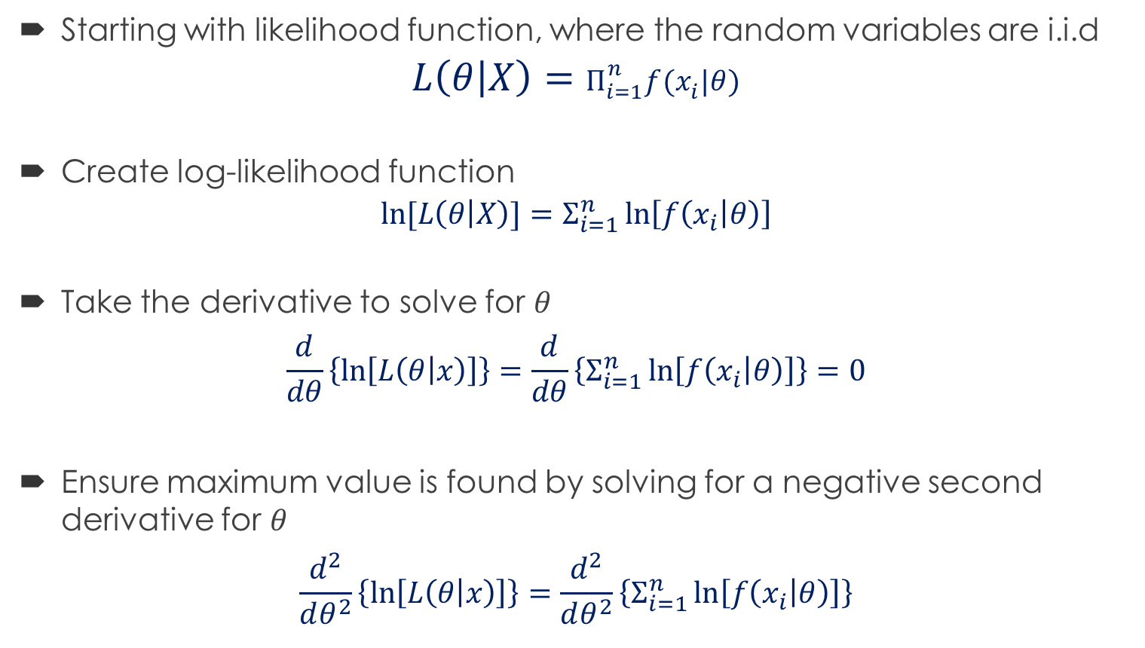
Maximum Likelihood Estimation
Starting with likelihood function, where the random variables are i.i.d
$$L\left(θ | X\right)=Π_{i=1}^{n}f(x_{i}|θ)$$
Create log-likelihood function
$$ln⁡[L\left(θ | X\right)]=Σ_{i=1}^{n}\ln\left[f\left(x_{i} | θ\right)\right]$$
Take the derivative to solve for $θ$
$$\frac{d}{dθ}\left\{\ln\left[L\left(θ | x\right)\right]\right\}=\frac{d}{dθ}\left\{Σ_{i=1}^{n}\ln\left[f\left(x_{i} | θ\right)\right]\right\}=0$$
Ensure maximum value is found by solving for a negative second derivative for $θ$
$$\frac{d^{2}}{dθ^{2}}\left\{\ln\left[L\left(θ | x\right)\right]\right\}=\frac{d^{2}}{dθ^{2}}\left\{Σ_{i=1}^{n}\ln\left[f\left(x_{i} | θ\right)\right]\right\}$$
Notes:
With the maximum likelihood estimate, we want to start with the likelihood function. The likelihood function is described as the likelihood that the parameter theta comes from the random variable X, where X is i.i.d. The parameters can be described as the mean, mu, the standard deviation, or variance, sigma and sigma squared respectively.
The likelihood function is then equal to the product of the probability density or mass function. The probability mass function is a function to determine the probability of getting the data point x of i given the parameter value (mu, sigma, or sigma squared).
The log-likelihood function is then used to simplify the problem. The natural log of a product becomes the sum, and the pmf are logged.
Then we want to solve for the parameter theta. To do this, we take the derivative of the log-likelihood function with respect to theta, set the function equal to zero, and solve for theta.
Ensuring that the maximum was found, the second derivative of the log-likelihood is taken with respected to theta to find the value is negative.

Slide 4
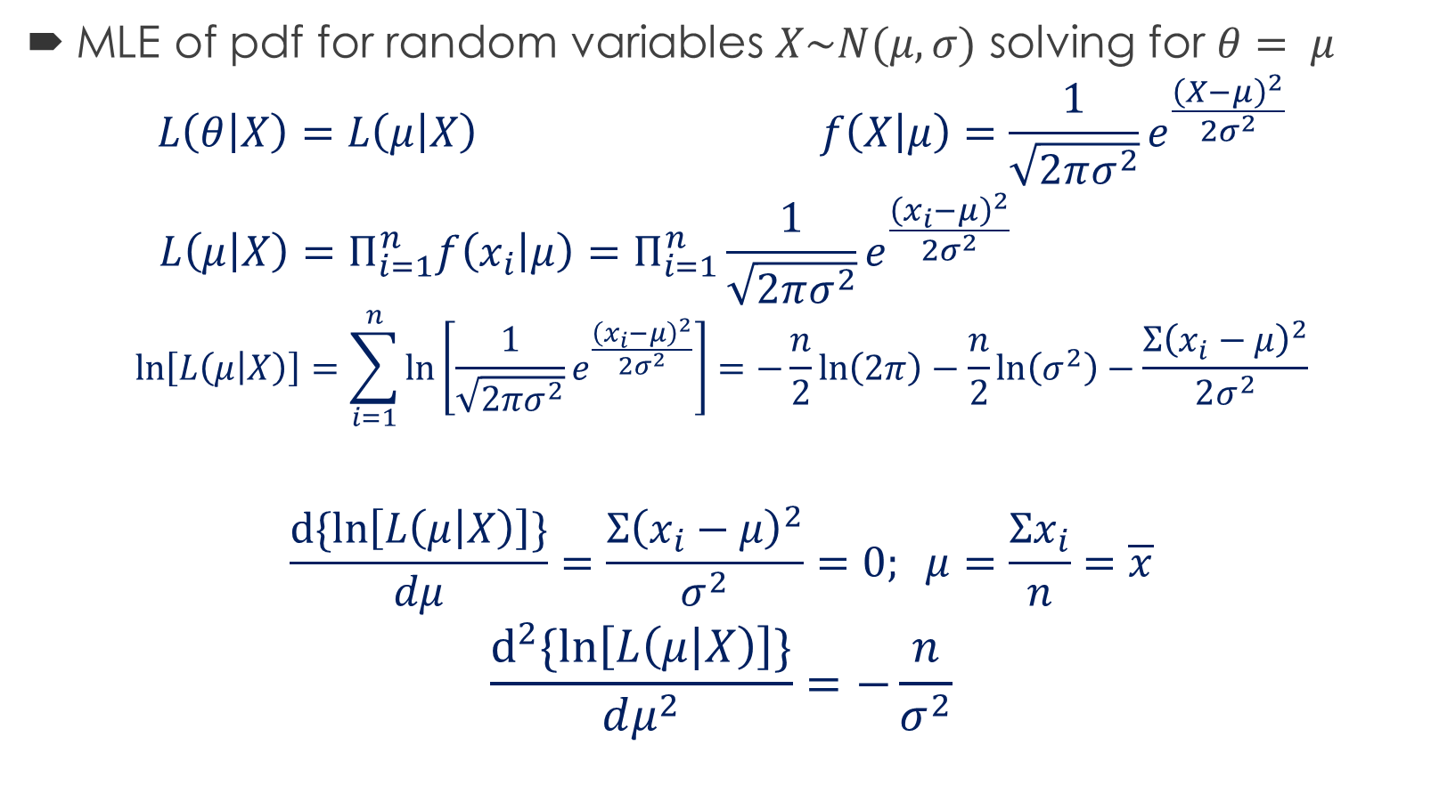
Maximum Likelihood Estimation – For Normal Probability Distribution
MLE of pdf for random variables $X\sim N(μ,σ)$ solving for $θ= μ$
$$L\left(θ | X\right)=L\left(μ | X\right) f\left(X | μ\right)=\frac{1}{\sqrt{2πσ^{2}}}e^{\frac{{\left(X−μ\right)}^{2}}{2σ^{2}}}$$
$$L\left(μ | X\right)=Π_{i=1}^{n}f\left(x_{i} | μ\right)=Π_{i=1}^{n}\frac{1}{\sqrt{2πσ^{2}}}e^{\frac{{\left(x_{i}−μ\right)}^{2}}{2σ^{2}}}$$
$$\ln\left[L\left(μ | X\right)\right]=\sum_{i=1}^{n}{\ln\left[\frac{1}{\sqrt{2πσ^{2}}}e^{\frac{{\left(x_{i}−μ\right)}^{2}}{2σ^{2}}}\right]=−\frac{n}{2}\ln\left(2π\right)−\frac{n}{2}\ln\left(σ^{2}\right)−\frac{Σ{\left(x_{i}−μ\right)}^{2}}{2σ^{2}}}$$
$$\frac{d\{ln\left[L\left(μ | X\right)\right]\}}{dμ}=\frac{Σ{\left(x_{i}−μ\right)}^{2}}{σ^{2}}=0; μ=\frac{Σx_{i}}{n}=\overline{x}$$
$$\frac{d^{2}\{ln\left[L\left(μ | X\right)\right]\}}{dμ^{2}}=−\frac{n}{σ^{2}}$$
Notes:
Here we derive the maximum likelihood estimate for a normal distribution to find the parameter mu.

Slide 5

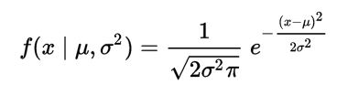

Likelihood Function
dnorm()

Slide 6


Likelihood function
R: result = 0

Slide 7
Expectation Maximization (EM) Algorithm – The Background
What if the dataset is mixture of models?
A single distribution maximum likelihood will not be sufficiently accurate
The EM algorithm is machine learning algorithm used to compute the maximum likelihood estimate of parameters in a set of data
[4] https://commons.wikimedia.org/wiki/File:Em_old_faithful.gif
Notes:
When using a dataset with multiple distributions, the maximum likelihood estimate would be the mode of the largest distribution within the data set.
The expectation maximization algorithm will provide more useful information about the dataset while solving for information that can be found in maximum likelihood estimates.
In short, the EM algorithm is a machine learning technique that computes the maximum likelihood estimates for multiple parameters depending the user’s input. The algorithm requires some user input to help classify the best estimation based on the number of modes. However, the number of modes can be determined mathematically, after the iterations of different number of modes have been done. Overall, the EM algorithm is considered a clustering technique because it categorizes what data points belong to which set parameters by estimating the correct parameters from the data points.
In the image to the right, we can see the waiting time and eruption time of the Old Faithful geyser, which is out in Yellowstone. Given the raw data and the assumption that there are two modes, the EM algorithm iteratively optimizes the parameters for the modes to find the best fit of this data, where the optimization is based on the principles of the maximum likelihood.

Slide 8
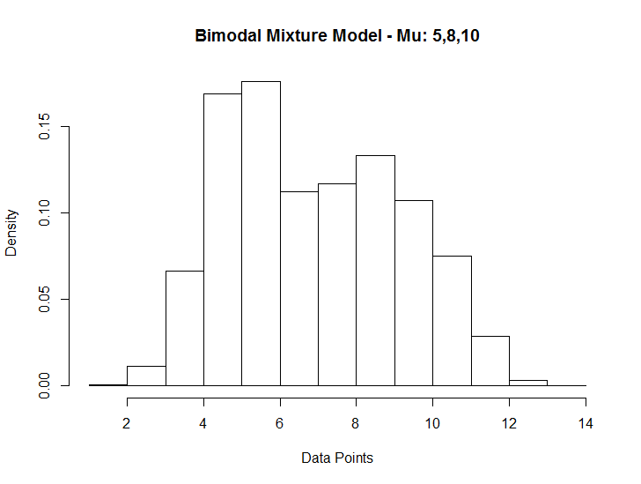
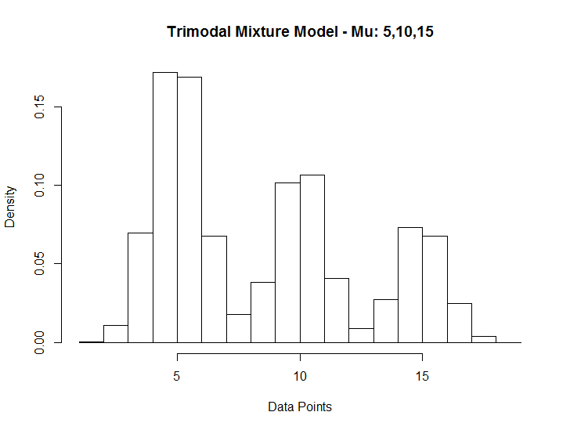
Expectation Maximization (EM) Algorithm – High Level Algorithm
Mixture model can also be easily identified as multimodal distribution within a histogram
Each distribution will have a proportional effect of the total dataset
Notes:
The mixture models we will be looking at will be in a histogram, where the information about the modes can be seen. By looking at the raw data, we can provide some insight on the structure and the type of information we may want to pick out from the data. Where in the first graph, we see two modes and the second graph we see three.
When talking about a mixture model, we also want to look at the proportion or percentage of the dataset that can be attributed to a certain distribution with its unique set of parameters. For the two mode graph, 1 mode have a larger percentage over the other. And in the three mode graph, we can see that the distribution with mean 5 is the largest, mean 10 is the second largest, and mean 5 is the smallest. The information we can take from this is that the larger percentage mode has a higher likelihood of being presented in the data.
What I also want to point out is that both graphs use 3 normal distributions of mu: 5,8,and 10, and 5,10, and 15, all with standard deviation of 1. But by looking at the first graph, we can only visually see 2 modes. So when running the EM algorithm, the most reasonable results we should expect to get is when we use 2 modes; however, that is not 100 percent accurate. The reason I am bringing this up is that the EM algorithm is our best estimation of the data based on the number of modes, and the algorithm should be understood in such a way, an estimation of parameters.
P_1
P_2 = 1 – P_1

Slide 9
Expectation Maximization (EM) Algorithm – Histogram Code
# Two histograms of tri-modal mixture models
pi1 <- 0.5
pi2 <- 0.3
pi3 <- 0.2
hardTri <- c(rnorm(10000*pi1,mean = 5),rnorm(10000*pi2,mean = 8),rnorm(10000*pi3, mean = 10))
hist(hardTri, prob = T, main = 'Bimodal Mixture Model - Mu: 5,8,10', xlab = 'Data Points')
pi1 <- 0.5
pi2 <- 0.3
pi3 <- 0.2
easyTri <- c(rnorm(10000*pi1,mean = 5),rnorm(10000*pi2,mean = 10),rnorm(10000*pi3, mean = 15))
hist(easyTri, prob = T, main = 'Trimodal Mixture Model - Mu: 5,10,15', xlab = 'Data Points')

Slide 10
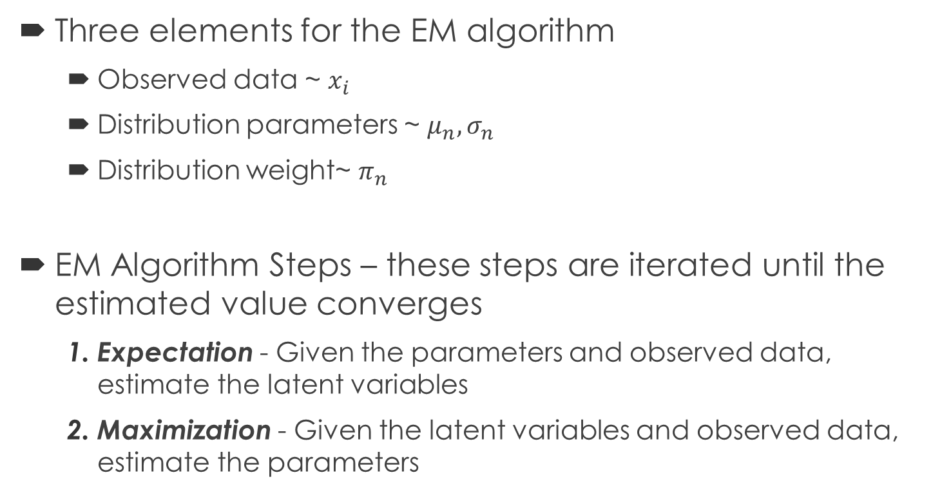
Expectation Maximization (EM) Algorithm – High Level Algorithm Continued
Three elements for the EM algorithm
Observed data ~ $x_{i}$
Distribution parameters ~ $μ_{n},σ_{n}$
Distribution weight~ $π_{n}$
EM Algorithm Steps – these steps are iterated until the estimated value converges
Expectation - Given the parameters and observed data, estimate the latent variables
Maximization - Given the latent variables and observed data, estimate the parameters
Notes:
Now that we have a grasp on what we should expect, here are the element that are needed to use the EM algorithm. We need the observed data, denoted as x i. We want to know what parameters we want to estimate. This information is based on type of probability distribution that would be used. Here we use the information for normal, so both mu of n and sigma of n will be estimate here. N helps denote which distribution the parameters will be estimating, where the distribution estimate is based on the number of modes. Last thing we need is the distribution weight denoted as pi of n.
From there, we can jump into the EM algorithm. The goal here is to iterated through the expectation and maximization steps until the parameters we are estimating converges.
The expectation step takes in the parameter values and observed data to estimate “latent variables.” I will go through what latent variables are more later on, but for now we can think of them as variables that are not observed, but provide information about the data.
The next step is the maximization. The maximization step takes the latent variable estimated in the expectation step, along with the observed data, and estimates new parameters.
The parameters get fed back into the expectation step and then you can see the snowball rolling. Luckily, we can stop when we reach convergence of the parameters.

Slide 11
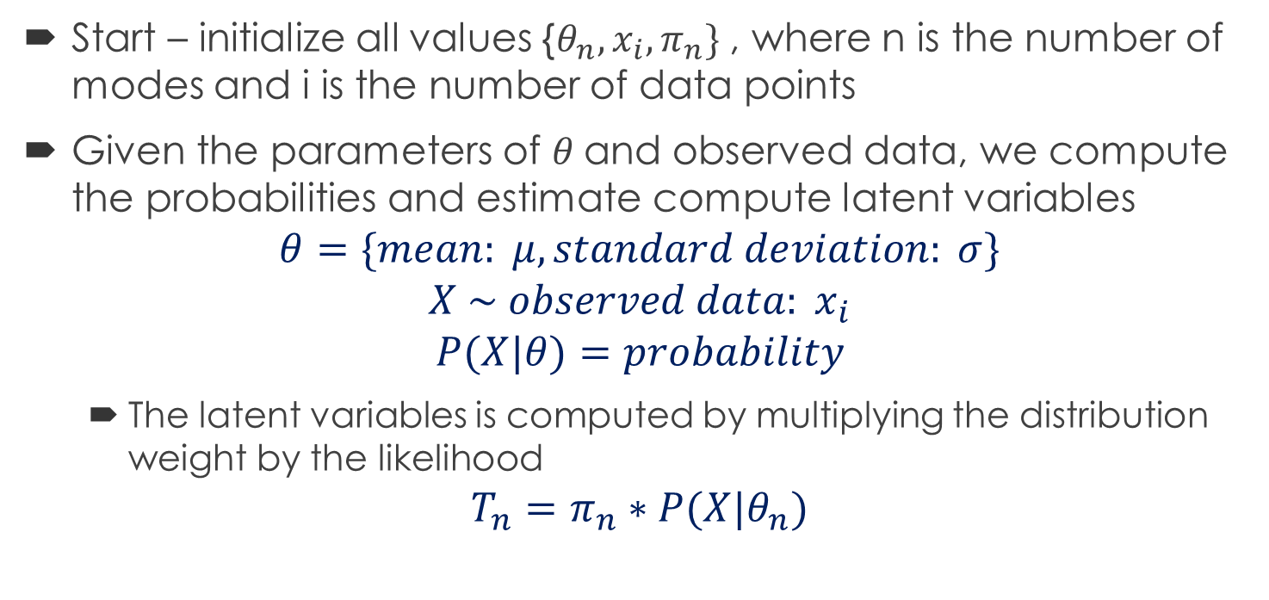
EM Algorithm - Expectation
Start – initialize all values {$θ_{n},x_{i},π_{n}\}$ , where n is the number of modes and i is the number of data points
Given the parameters of $θ$and observed data, we compute the probabilities and estimate compute latent variables
$$θ=\{mean: μ, standard deviation: σ\}$$
$$X \sim observed data: x_{i}$$
$$P(X|θ)=probability$$
The latent variables is computed by multiplying the distribution weight by the likelihood
$$T_{n}=π_{n}∗P(X|θ_{n})$$
Notes:
The first step is the expectation step. Here we provide an initial value for the parameters mu and sigma, the observed data, and initial values of the distribution weights, pi.
Just to reiterate for completeness:
N denotes the modes, where the number of modes is chosen.
I is the number of data points in our data set
Using the observed data and the parameters mu and sigma, we can compute the probabilities, where for the parameter mu, what is the probability that x comes from that distribution.
Associating the weight of pi and a computed probability of the parameter theta given the data points, we get the latent variable.
We know that the sampled data must come from some distribution, but we do not know which distribution. The value of the latent variable, the unseen/unobserved variable is the approximated proportions of the distribution. We can make connections and links to whether a data point comes from distribution A or B by its likelihood or probability that data point comes from that distribution.

Slide 12
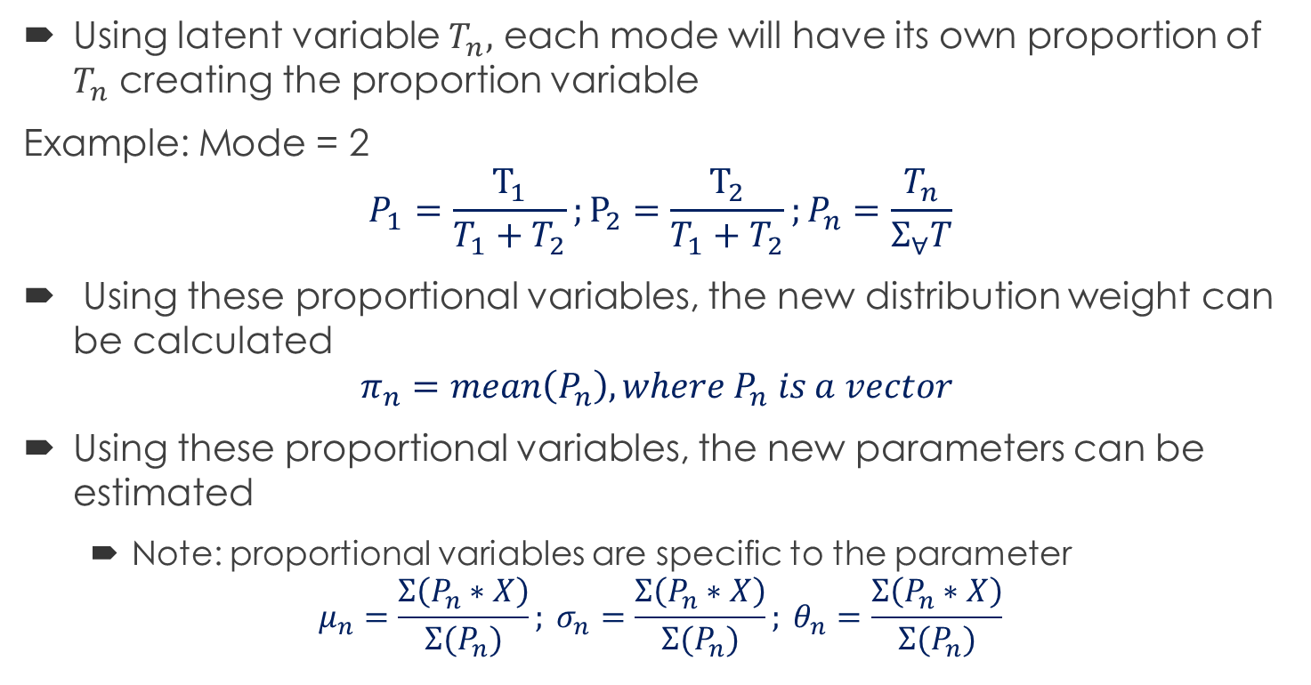
EM Algorithm - Maximization
Using latent variable $T_{n},$ each mode will have its own proportion of $T_{n}$ creating the proportion variable
Example: Mode = 2
$$P_{1}=\frac{T_{1}}{T_{1}+T_{2}};P_{2}=\frac{T_{2}}{T_{1}+T_{2}};P_{n}=\frac{T_{n}}{Σ_{∀}T}$$
Using these proportional variables, the new distribution weight can be calculated
$$π_{n}=mean\left(P_{n}\right), where P_{n} is a vector$$
Using these proportional variables, the new parameters can be estimated
Note: proportional variables are specific to the parameter
$$μ_{n}=\frac{Σ\left(P_{n}∗X\right)}{Σ(P_{n})}; σ_{n}=\frac{Σ\left(P_{n}∗X\right)}{Σ(P_{n})}; θ_{n}=\frac{Σ\left(P_{n}∗X\right)}{Σ(P_{n})}$$
[3] “Understanding the EM Algorithm”
Notes:
The latent variable makes the maximization step possible here, where we take the proportion of these latent variables. I denote these proportions as p of n, again where n is the specific mode.
So for an example of two modes, we can determine the proportion variable as that mode’s latent variable over the sum of all latent variables.
Now we can estimate a new distribution weight value, pi of n, by taking the mean of the proportion variable for that distribution.
We will also using the proportional variable to compute a new estimates of the parameter values: mu and sigma here. Where the sum of the product of the proportion variable and the observed data divided by the sum of the proportion variable is the new parameter estimate.

Slide 13
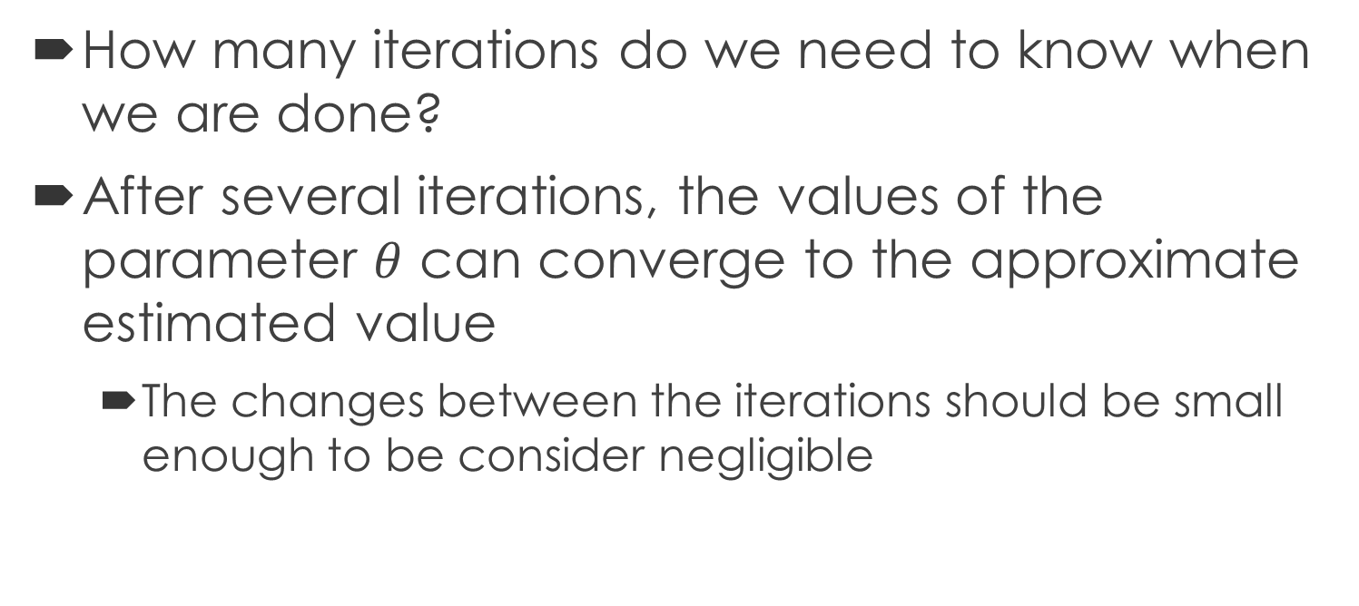
EM Algorithm – Convergence
How many iterations do we need to know when we are done?
After several iterations, the values of the parameter $θ$ can converge to the approximate estimated value
The changes between the iterations should be small enough to be consider negligible
Notes:
Lastly, we want to know when we should be done. When do we know we have a good enough answer?
Here we expect to be complete when the parameter values, theta, converge to their best fit estimate. Convergence is where the change of the parameter value is negligible between iterations.

Slide 14
Validating our work
Problem: After running several different modes of the EM algorithm, how can I determine which number of modes is the best approximation of the data?
Solution: Use AIC/BIC to estimated number of modes that best fits the data

Slide 15

Akaike Information Criterion (AIC)
Definition
A measure of the relative quality of statistical models for a given set data
Core idea of AIC
Minimize the estimated lost information
AIC process
Start with a set of candidate models
Get the corresponding AIC value for each model
Compare these values to get the minimum one

Slide 16
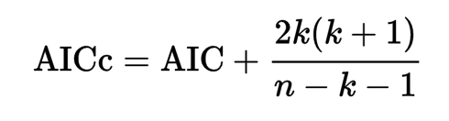
Akaike Information Criterion Correction (AICc)
Definition
AIC with a correction for finite sample sizes.
Assumption
The model is univariate
Linear
Has normally distributed residuals
Formula

Slide 17

Bayesian Information Criterion (BIC)
Definition
Bayesian approach to reducing information loss
Theoretical disadvantage of BIC
Not derive from the principles of information
Not sensible because of 1/R, which is relative to the number of the models
AIC is much easier in simulation work

Slide 18
Shiny Demonstration
https://gn8bamboo.shinyapps.io/Project/

Slide 19
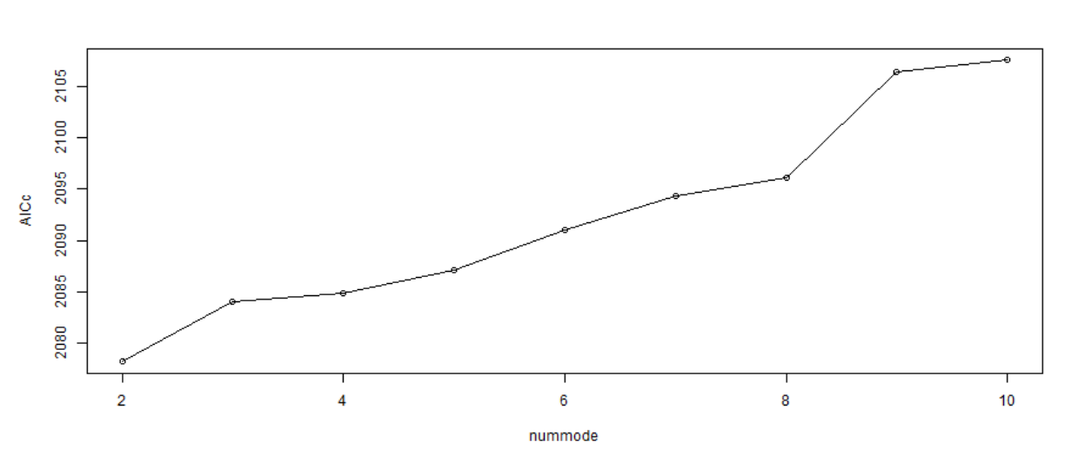
AICc Plot for 10 modes

Slide 20
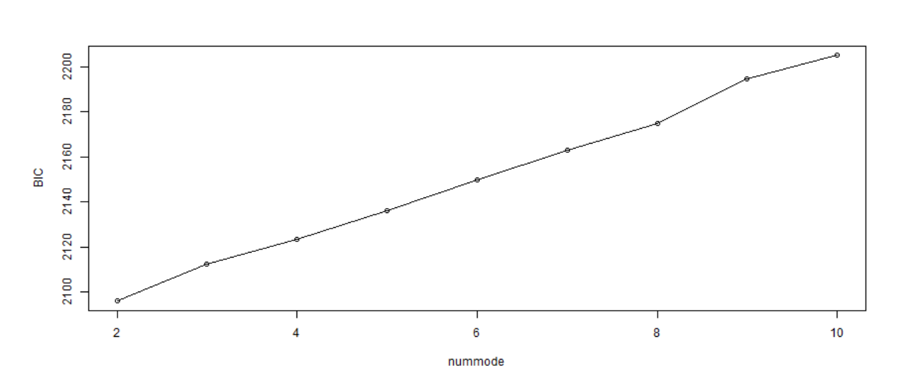
BIC Plot for 10 modes

Slide 21
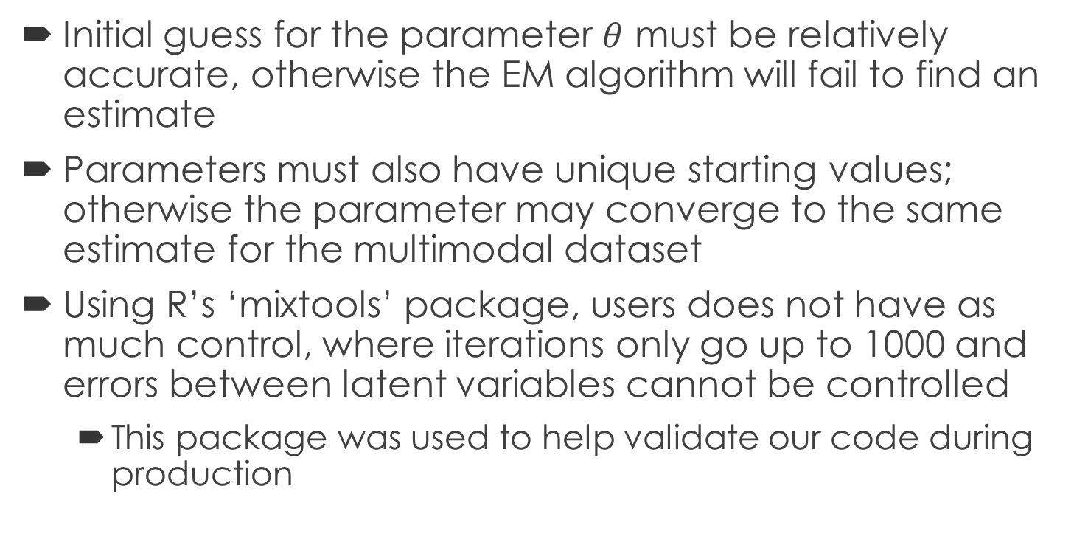
Notes on the EM Algorithm
Initial guess for the parameter $θ$ must be relatively accurate, otherwise the EM algorithm will fail to find an estimate
Parameters must also have unique starting values; otherwise the parameter may converge to the same estimate for the multimodal dataset
Using R’s ‘mixtools’ package, users does not have as much control, where iterations only go up to 1000 and errors between latent variables cannot be controlled
This package was used to help validate our code during production
Notes:
Repeat EM algorithm until we get parameter, converge value is log-likelihood

Slide 22
EM algorithm limitation
Initial value:
Problem: we can’t set same value or zero for each mean value
Solution: (max-min)/(# of modes - 1)

Slide 23
References
JMP Statistical Discovery from SAS, “Likelihood, AICc, and BIC”, Accessed: Dec 5, 2016, http://www.jmp.com/support/help/Likelihood_AICc_and_BIC.shtml
Chan, Fong Chun, “Fitting a Mixture Model Using the Expectation-Maximization Algorithm in R”, Jan 3 2016, Accessed: Dec 1 2016 http://tinyheero.github.io/2016/01/03/gmm-em.html
“Understanding the EM Algorithm”, Accessed: Nov 9th 2016, http://rstudio-pubs-static.s3.amazonaws.com/1001_3177e85f5e4840be840c84452780db52.html
“An animation of the EM algorithm to a 2 component Gaussian mixture model on the Old Faithful dataset“, Mar 23 2009, https://commons.wikimedia.org/wiki/File:Em_old_faithful.gif

